Slide 1
Naïve Bayes’ Classifier
Parametric, Multi-Class Classification Technique

Slide 2
About
Naive Bayes performs well when we have multiple classes (several categories to classify into) and working with text classification.
It is simple and if the conditional independence assumption actually holds (all outcomes are mutually exclusive), a Naive Bayes classifier will converge quicker than discriminative models like logistic regression, so you need less training data.
It requires less model training time. Training is fast because only the probability of each class and the probability of each class given different input (x) values need to be calculated. No coefficients need to be fitted by optimization procedures.
Suitable for doing POCs and making real time predictions.
The NB models cannot represent complex behavior so it won’t get into over-fitting.

Slide 3
Things to Understand
Naive Bayes works best when you have small training data set, relatively small number of features (dimensions/ independent variables). If you have huge feature list, the model may not give you accuracy, because the likelihood would be distributed and may not follow the Gaussian or other distribution.
Another condition for Naive Bayes to work is that features should be independent of each other. Try to analyze how each features are related to each other, if they are they affecting the occurrence of each other. If they are mutually exclusive, Naive Bayes can give you good result.

Slide 4
Use of Probability
Class Probabilities: The probabilities of each class (every outcome in the dependent variable) in the training dataset.
Conditional Probabilities: The conditional probabilities of each input value given each class value

Slide 5
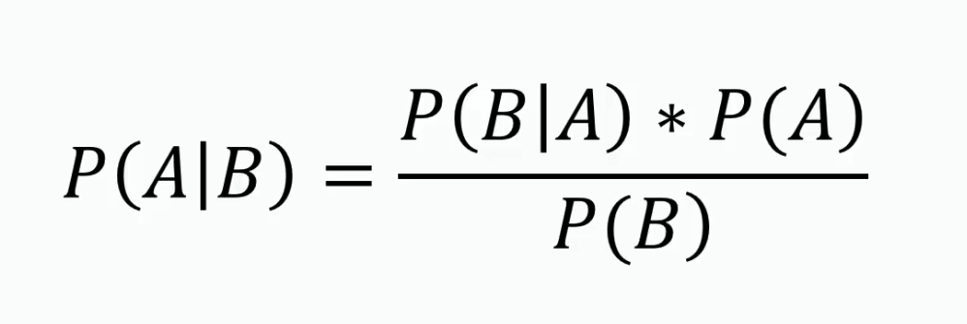
Bayes’ Theorem
Bayes’ theorem is a way to figure out conditional probability. Conditional probability is the probability of an event happening, given that it has some relationship to one or more other events. For example, your probability of getting a parking space is connected to the time of day you park, where you park, and what conventions are going on at any time. Bayes’ theorem is slightly more nuanced. In a nutshell, it gives you the actual probability of an event given information about tests.

Slide 6
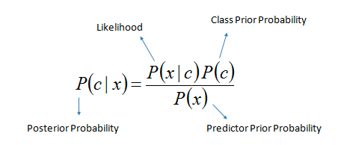





Slide 7
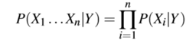
Likelihood
Here, X represents the attributes or features, and Y is the response variable. Now, P(X|Y) becomes equal to the products of, probability distribution of each attribute X given Y.

Slide 8
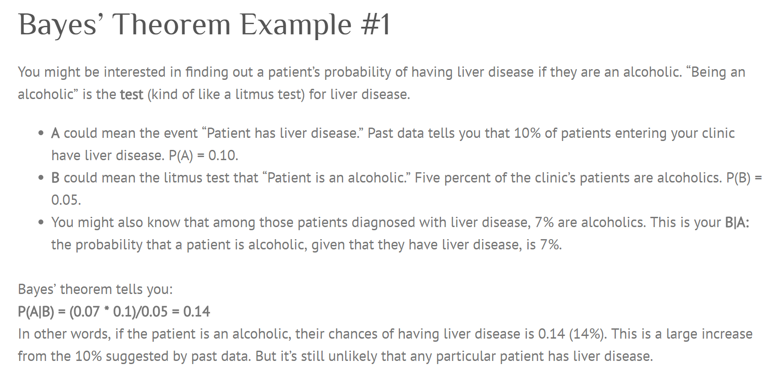

Slide 9
Example Problem
Given a dataset of people and their mode of commute, we will try to figure out the mode of commute of another person.
Every person in the dataset has attributes – Age and Salary.
Our goal is to analyse these attributes and determine the mode of commute for someone outside this group of people.

Slide 10
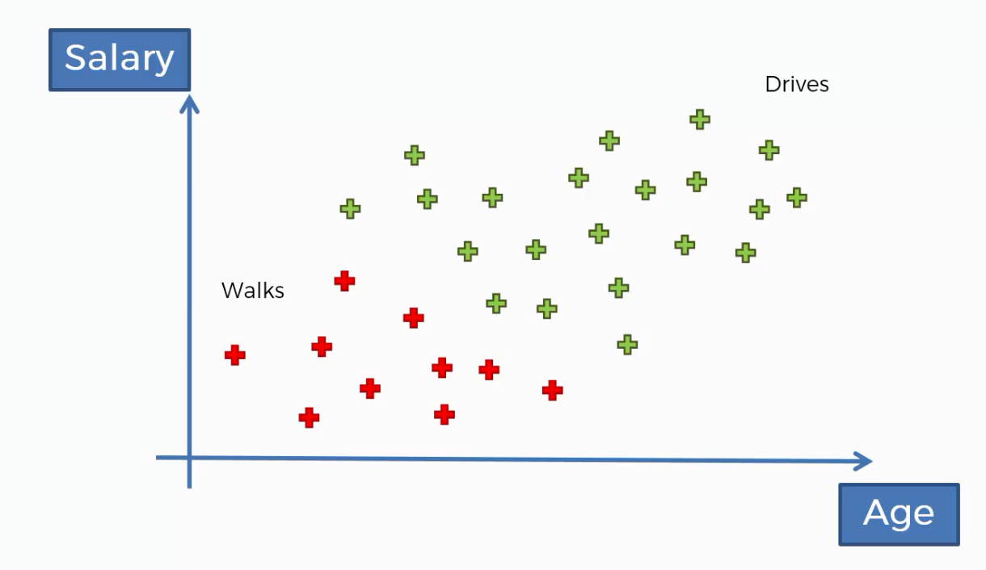

Slide 11
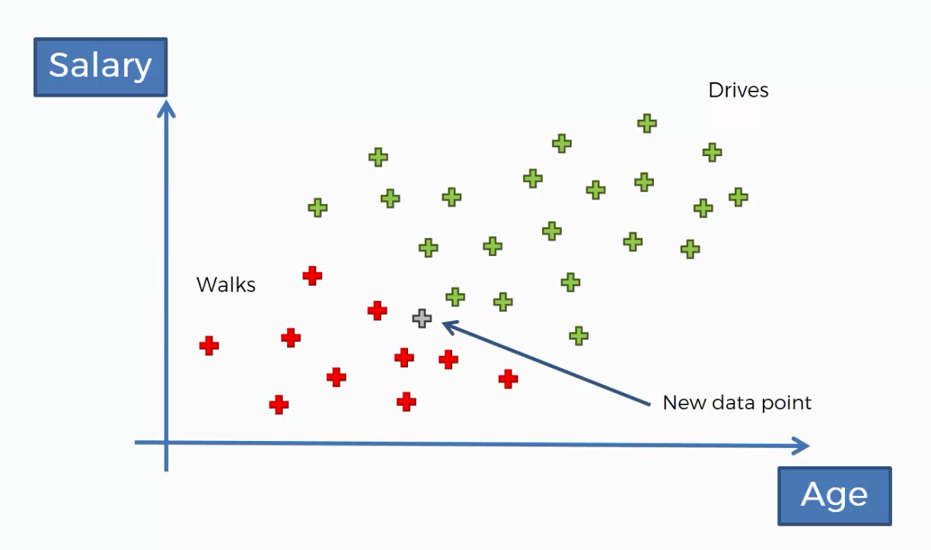

Slide 12

Steps to solving this example problem:
Find the probability of the person Walking
Find the probability of the person Driving
Compare the probabilities. The higher one wins.

Slide 13
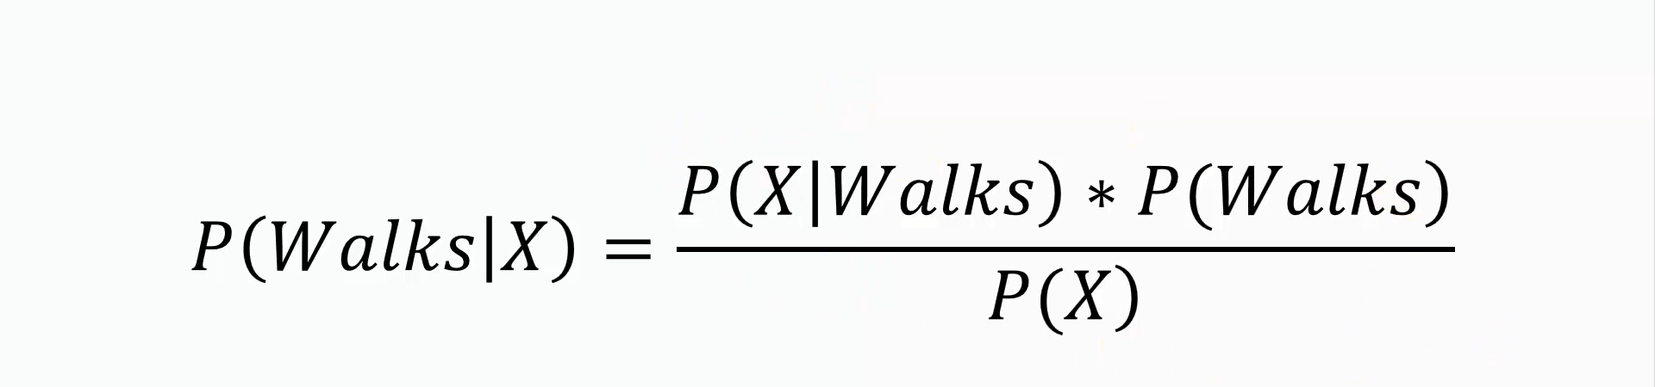
Step 1: The probability of Walking

Slide 14
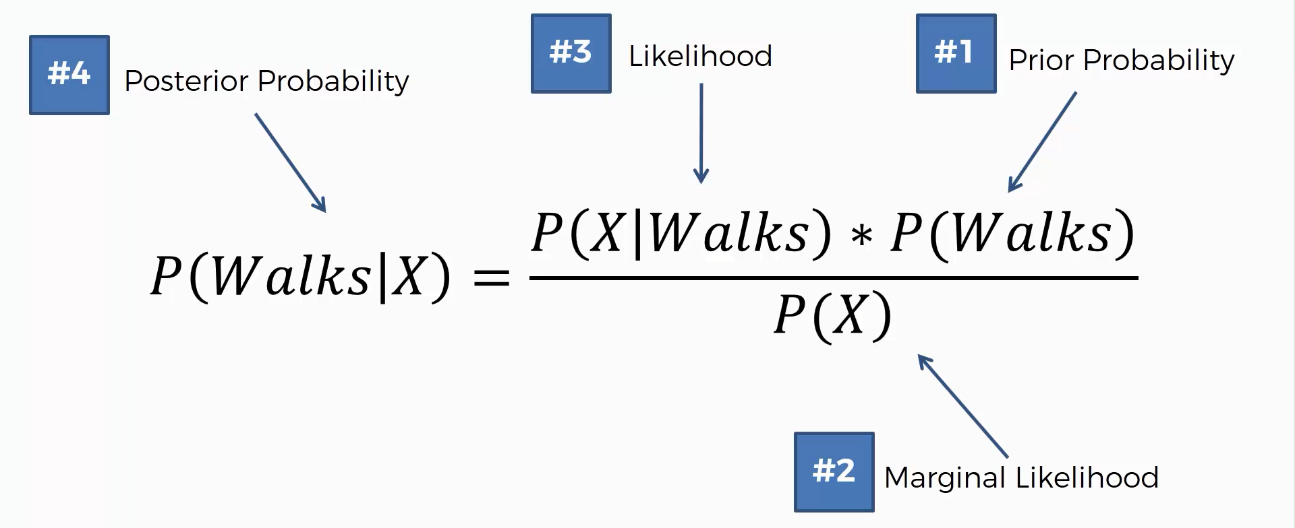

Slide 15
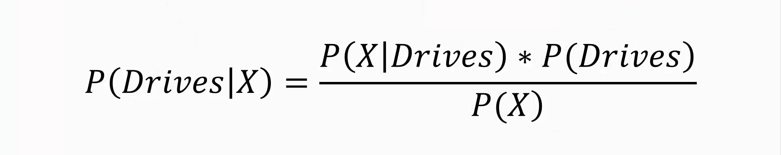
Step 2: The probability of Driving

Slide 16
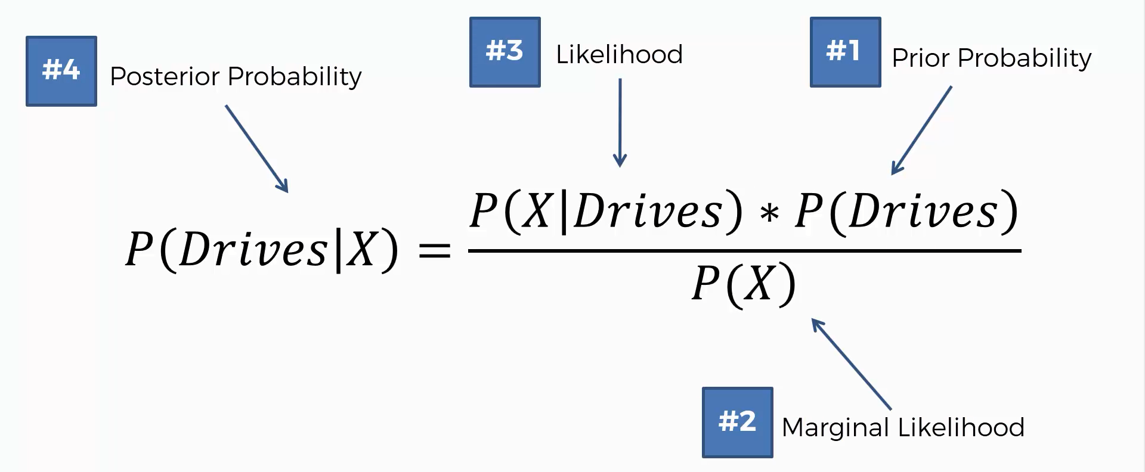

Slide 17
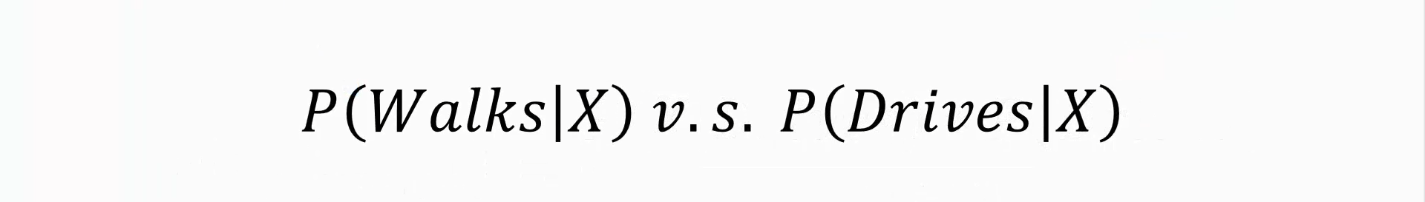
Step 3: Comparing both the probabilities

Slide 18
Lets find the Estimation using a Naïve Bayes Classifier

Slide 19
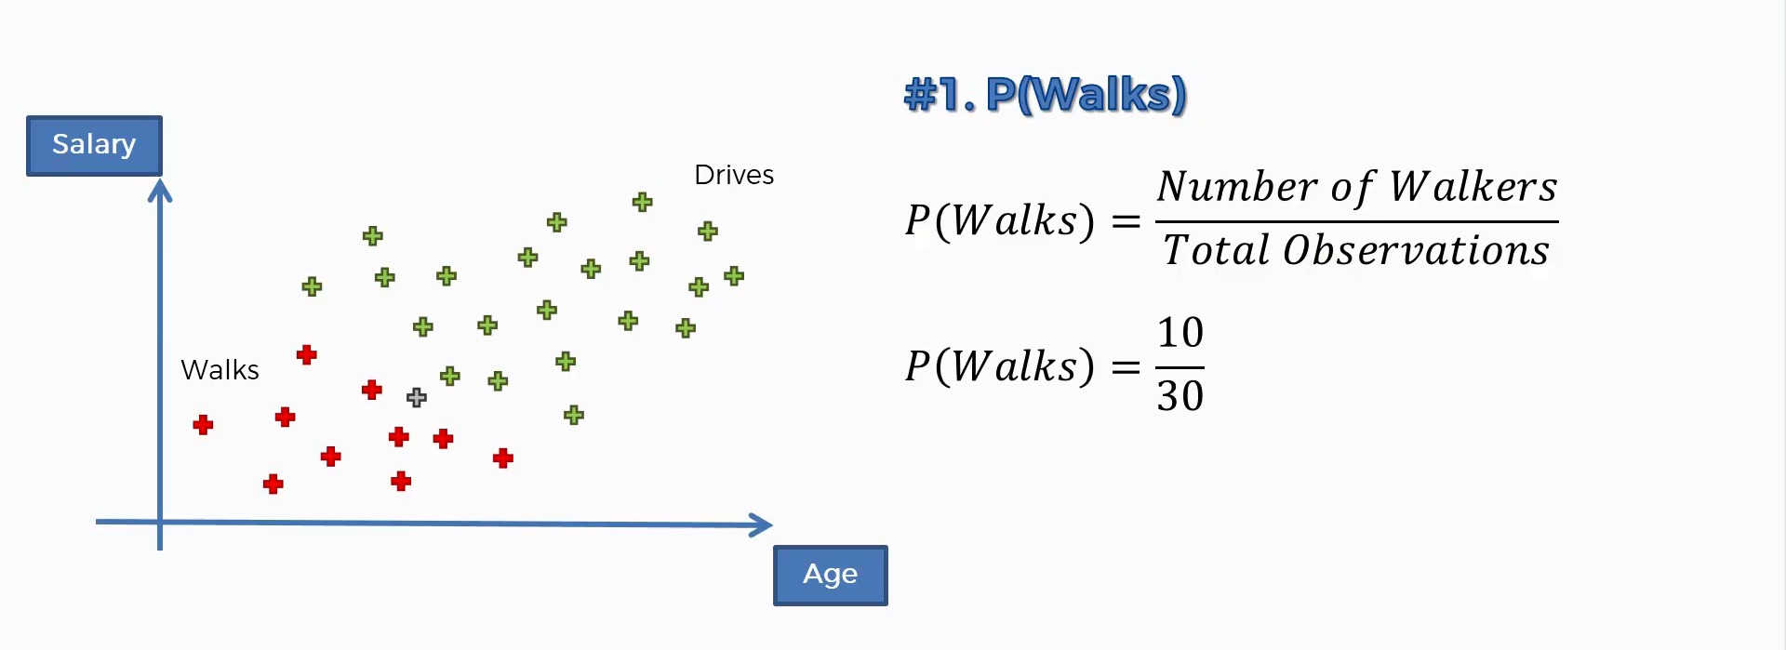

Slide 20
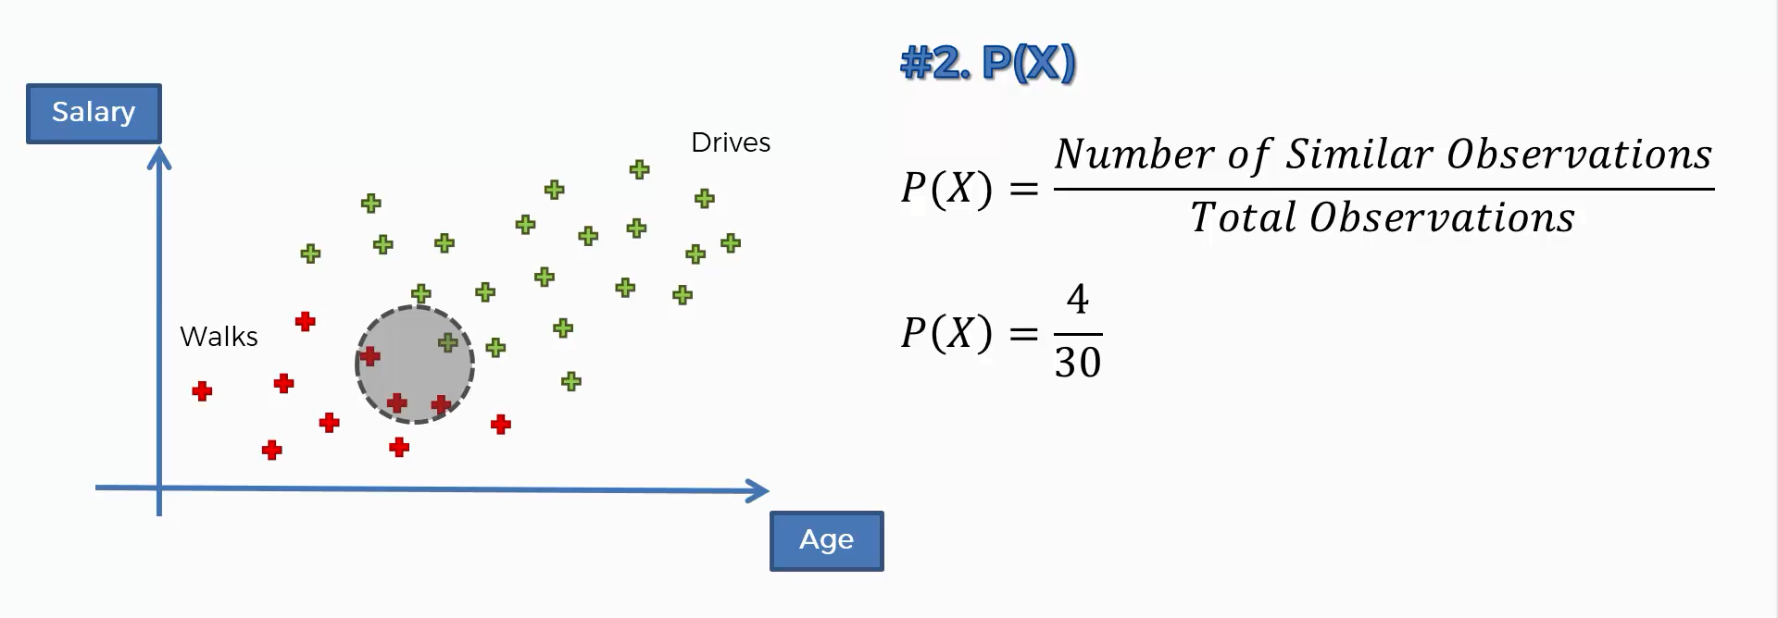

Slide 21
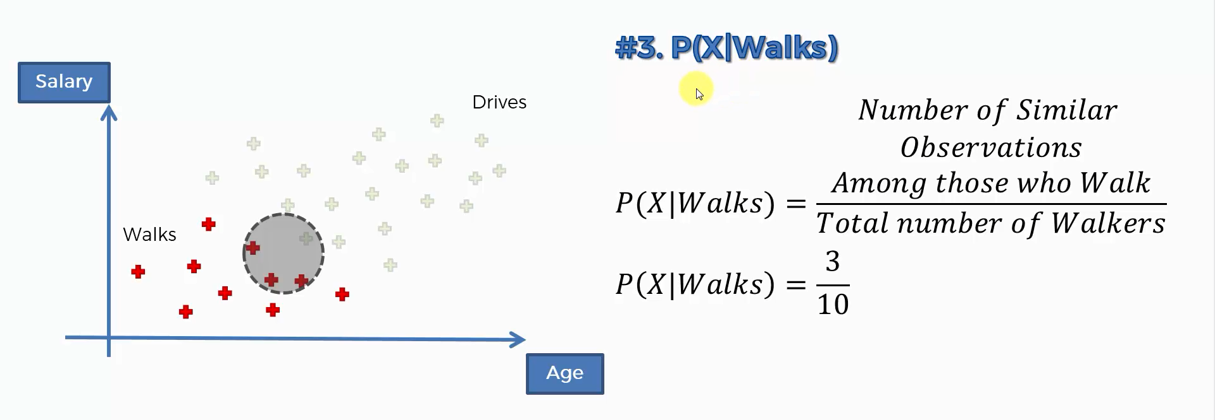

Slide 22
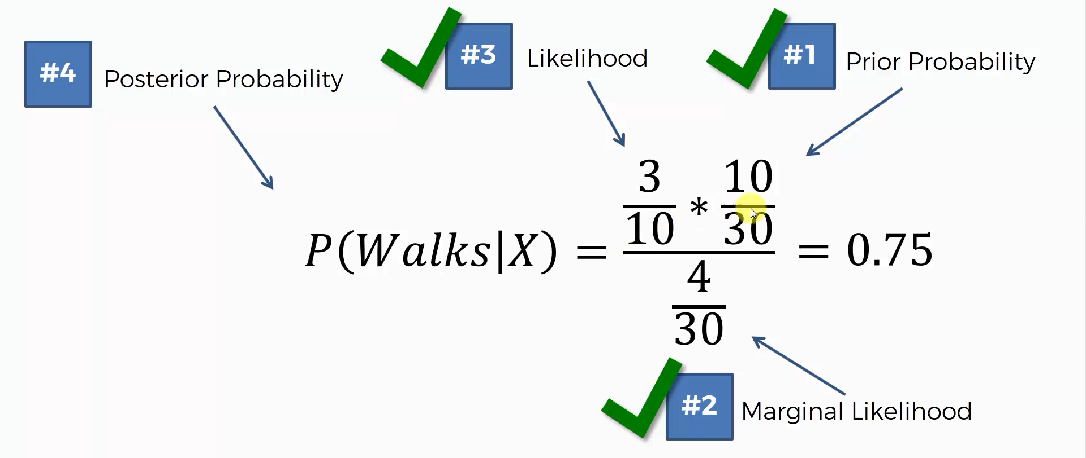

Slide 23
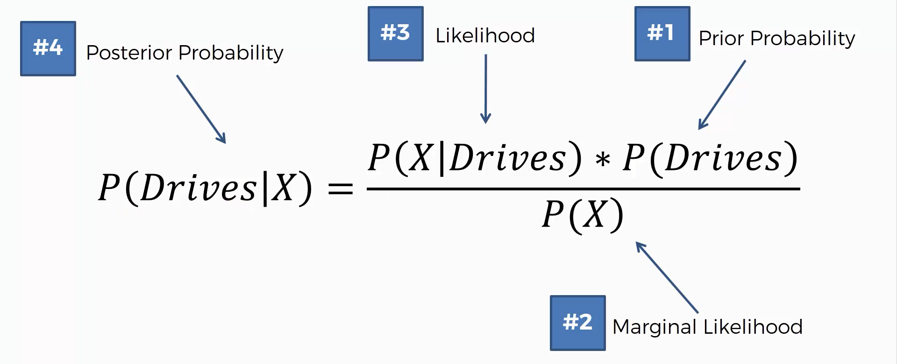

Slide 24
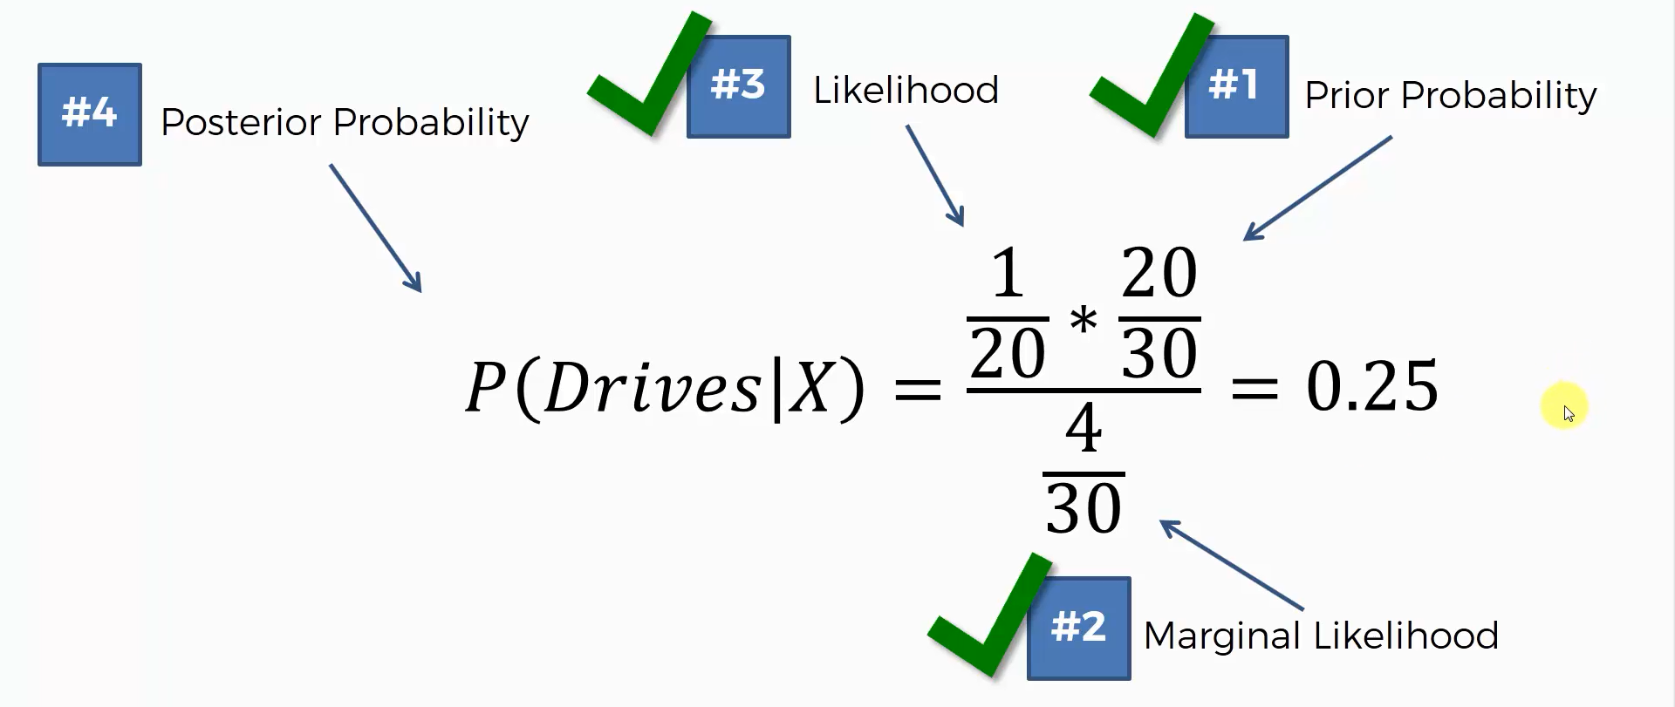

Slide 25
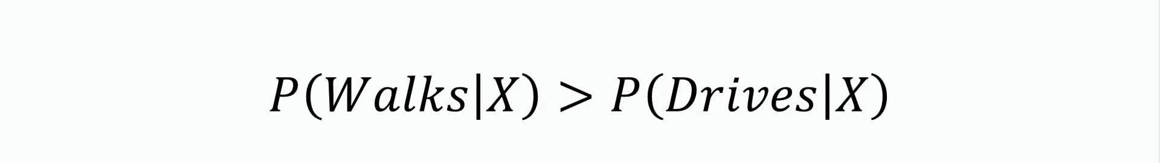

Slide 26
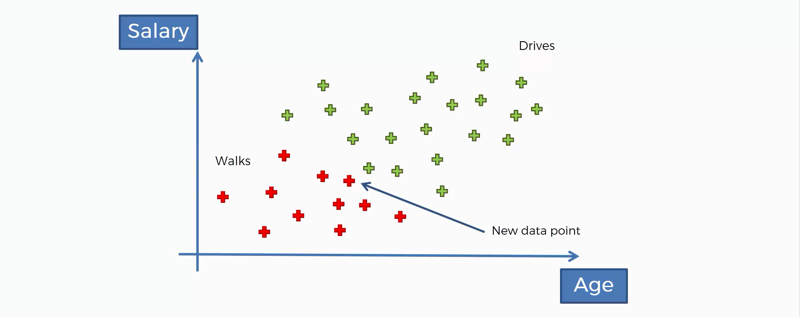

Slide 27
Gaussian Naive Bayes
Naive Bayes can be extended to real-valued attributes, most commonly by assuming a Gaussian distribution.
This extension of Naive Bayes is called Gaussian Naive Bayes. Other functions can be used to estimate the distribution of the data, but the Gaussian (or Normal distribution) is the easiest to work with because you only need to estimate the mean and the standard deviation from your training data.
Gaussian Inputs: If the input variables are real-valued, a Gaussian distribution is assumed. In which case the algorithm will perform better if the univariate distributions of your data are Gaussian or near-Gaussian. This may require removing outliers (e.g. values that are more than 3 or 4 standard deviations from the mean).

Slide 28
Naïve Bayes Models in Python’s sklearn
There are three types of Naive Bayes model under scikit learn library:
Gaussian: It is used in classification and it assumes that features follow a normal distribution.
Multinomial: It is used for discrete counts. For example, let’s say, we have a text classification problem. Here we can consider Bernoulli trials which is one step further and instead of “word occurring in the document”, we have “count how often word occurs in the document”, you can think of it as “number of times outcome number x_i is observed over the n trials”.
Bernoulli: The binomial model is useful if your feature vectors are binary (i.e. zeros and ones). One application would be text classification with ‘bag of words’ model where the 1s & 0s are “word occurs in the document” and “word does not occur in the document” respectively.

Slide 29
Improving the Naive Bayes Model
If continuous features do not have normal distribution, we should use transformation or different methods to convert it in normal distribution.
If test data set has zero frequency issue, apply smoothing techniques “Laplace Correction” to predict the class of test data set.
Remove correlated features, as the highly correlated features are voted twice in the model and it can lead to over inflating importance.
Naive Bayes classifiers has limited options for parameter tuning like alpha=1 for smoothing, fit_prior=[True|False] to learn class prior probabilities or not and some other options (look at detail here). I would recommend to focus on your pre-processing of data and the feature selection.
You might think to apply some classifier combination technique like ensembling, bagging and boosting but these methods would not help. Actually, “ensembling, boosting, bagging” won’t help since their purpose is to reduce variance. Naive Bayes has no variance to minimize.
If the input variables are real-valued, a Gaussian distribution is assumed. In which case the algorithm will perform better if the univariate distributions of your data are Gaussian or near-Gaussian. This may require removing outliers (e.g. values that are more than 3 or 4 standard deviations from the mean).

Slide 30
Applications of Naïve Bayes Classifier
Real time Prediction: Naive Bayes is an eager learning classifier and it is sure fast. Thus, it could be used for making predictions in real time.
Multi class Prediction: This algorithm is also well known for multi class prediction feature. Here we can predict the probability of multiple classes of target variable.
Text classification/ Spam Filtering/ Sentiment Analysis: Naive Bayes classifiers mostly used in text classification (due to better result in multi class problems and independence rule) have higher success rate as compared to other algorithms. As a result, it is widely used in Spam filtering (identify spam e-mail) and Sentiment Analysis (in social media analysis, to identify positive and negative customer sentiments)
Recommendation System: Naive Bayes Classifier and Collaborative Filtering together builds a Recommendation System that uses machine learning and data mining techniques to filter unseen information and predict whether a user would like a given resource or not

Slide 31
Python’s sklearn Documentation
http://scikit-learn.org/stable/modules/naive_bayes.html
http://scikit-learn.org/stable/modules/generated/sklearn.naive_bayes.GaussianNB.html

